Slide 1


























Holy Cross School: A Catholic Voluntary Academy
SEND Information Report 24/25
Parsonwood Hill
LE67 5AT
01530 832799
St Thomas Aquinas
Catholic Multi-Academy Trust
“In the light of Jesus we Love, Listen and Grow”

Slide 2
About us…
Mrs C Murphy – Executive Head Teacher
Miss M Breeze – Head of School / DSL
Mrs S Massey – SENCO (MAT Leave)
Mr P Saxton –Interim SENCO psaxton@aquinas-cmat.org
Mrs N Ward – ELSA
School Office - school.office@whx.leics.sch.uk
___________ – SEND Governor
Website - http://www.holycrosswhitwick.co.uk/
Twitter - @holycwhitwick
Age range 3 to 11
Inspection: Ofsted (2023) – Good
“In the light of Jesus we Love, Listen and Grow”

Slide 3
What is in a SEND
Information Report?
• the kinds of SEN that are provided for
• policies for identifying children and young people with SEN and assessing their needs
• arrangements for consulting parents of children with SEN and involving them in their child’s education
• arrangements for consulting young people with SEN and involving them in their education
• arrangements for assessing and reviewing children and young people’s progress towards outcomes.
• arrangements for supporting children and young people in moving between phases of education and in preparing for adulthood.
• the approach to teaching children and young people with SEN
• how adaptations are made to the curriculum and the learning environment of children and young people with SEN
• the expertise and training of staff to support children and young people with SEN
• evaluating the effectiveness of the provision made for children and young people with SEN
• how children and young people with SEN are enabled to engage in activities available with children and young people in the school who do not have SEN
• support for improving emotional and social development.
• how the school involves other bodies, including health and social care bodies, local authority support services and voluntary sector organisations
• arrangements for handling complaints from parents of children with SEN about the provision made at the school
“In the light of Jesus we Love, Listen and Grow”

Slide 4
Our SEND Intent
Our philosophy encapsulates valuing each child as an individual, as well as part of a wider community. Unlocking potential and facilitating personal progress is at the forefront of all that we do. We believe that if children’s barriers to learning are removed or lowered then they will be better prepared for future life and achieve greater progress in all areas. We share the Academy Trust’s mission of shaping young people’s lives to the highest possible standards.
“In the light of Jesus we Love, Listen and Grow”

Slide 5
What people say…
Holy Cross “school is highly impressive and have high aspirations for young children with additional needs (SEN), hence [children] mature socially and emotionally. (C. Boorn, Educational Psychologist).
Our most recent OFSTED (2023) inspection stated the following, “Leaders are ambitious for all pupils to achieve well, especially the most disadvantaged and those with special educational needs and/or disabilities (SEND).”
“Leaders make regular checks on what pupils know. As a consequence, any gaps in pupils’ learning are swiftly identified. Teachers provide appropriate support. Pupils quickly catch up if they fall behind.”
“Pupils with SEND are and feel well supported. Staff are clear on what help these pupils require. This is because they work with the pupils to write individual plans. Targets for pupils with SEND are simple and understood. Teachers adapt learning to make it accessible and achievable for pupils with SEND. They know staff have high expectations of them.”
“In the light of Jesus we Love, Listen and Grow”

Slide 6
SEND at Holy Cross
Number of children in school 154
Number of SEND pupils 24 (15.5%)
Number of pupils with EHCP/top-up 5 (3.3%)
We make provision for ALL children including those who have learning difficulties and/or disabilities. We support children with…
Communication and Interaction (CI) e.g. Speech and language and autism
Cognition & Learning (CL) e.g. Dyslexia, Dyscalculia, moderate learning difficulties.
Social, Mental and Emotional Health (SMEH) e.g. Autism spectrum disorders
Sensory and/or physical (SD) e.g. visual impairment.
“In the light of Jesus we Love, Listen and Grow”

Slide 7
Quality first Teaching
‘Every Teacher is a Teacher of SEN’. Provision for children with SEND is a matter for the whole school. The governing body, the school’s Head teacher, the SENCO and all other members of staff, particularly class teachers and teaching assistants, have important day–to–day responsibilities. All children in school should be getting this as a part of excellent classroom practice. For your child this would mean:
Teacher has the highest possible expectations for your child and all pupils in their class.
Teaching is based on building on what your child already knows, can do and can understand.
Different ways of teaching are in place so that your child is fully involved in learning in class.
Specific strategies are in place to support your child to learn.
Assessment - Your child’s teacher will have carefully checked on your child’s progress and will have decided that your child has a gap in their understanding/learning and needs some extra support to help them make the best possible progress
“In the light of Jesus we Love, Listen and Grow”

Slide 8
What is SEND?
SEND stands for Special Educational Needs/Disabilities
Indicators of possible SENDs are…
Not similar to progress of peers starting from baseline
Below previous rate of progress
Attainment gap remains the same or widens between them and their peers
They do not make adequate progress despite appropriate interventions and adjustments and good quality personalised teaching.
Below expected rate of development (physically and mentally).
A significant difference in learning styles.
When a SpLD may be present.
If it is agreed by teachers, parents and the SENDCo then a child will be placed on our School SEND Register.
“In the light of Jesus we Love, Listen and Grow”

Slide 9
Assessing and Identifying
Teachers use the ‘Road to SEN’ to help guide them identification of SEND.
Teachers begin ‘Initial Concerns’ documents when they have a concern about a pupil’s progress.
Teachers assess all pupils at 5 key data points using in school assessment systems.
The SLT meet after assessment periods to identify groups who may require additional and/or different support.
Children who have SEND are continuously tracked using the Assess, Plan, Do, Review Cycle every 8 to 12 weeks. This tracking is based on personal targets.
The school also uses other forms of assessment such as checklists, small step trackers, Pre-key stage standards, assessments from other professionals and personal assessments linked to each individual.
“In the light of Jesus we Love, Listen and Grow”

Slide 10
Partnership -
Other Professionals
The SENDCo works closely with a variety of professionals.
Currently, Speech and Language Therapist, Educational Psychologists and Specialist Teaching services and medical professionals are all involved with a variety of pupils.
The school will regularly communicate with health professionals including GPs and community paediatricians
The school refers to the school nurse
Joe Dawson, Educational Psychologist, also works closely with the School and SENDCo
The school is part of the St Thomas Aquinas Catholic Multi-Academy Trust and works closely with a variety of specialist leaders.
“In the light of Jesus we Love, Listen and Grow”

Slide 11
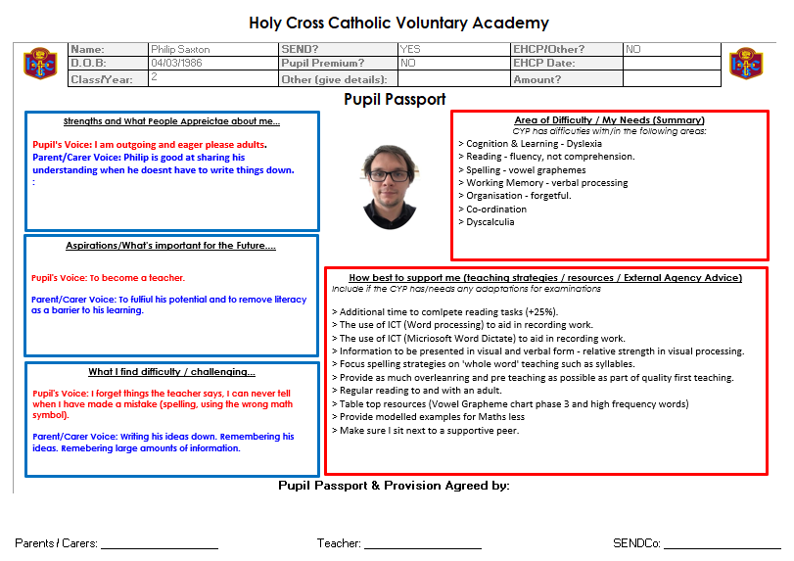
Partnership – Pupils & Parents
Children and families are at the centre.
Pupil Passports seek the views of family members and pupils.
Partnership between home and school increases pupil success.
Information about a child’s difficulty and the strategies they need is included.
“In the light of Jesus we Love, Listen and Grow”

Slide 12
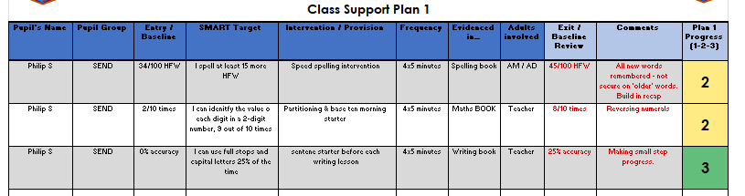
Class Outcome Plans
Assess every 8 to 12 weeks,
Plan next steps in collaboration with SENDCo, teachers, parents and pupils.
Do and implement agreed intervention and/or support
Review at the end of the 8 to 12 week cycle to inform progress and impact.
Repeat the process again and improve/change practice, if applicable.
“In the light of Jesus we Love, Listen and Grow”

Slide 13
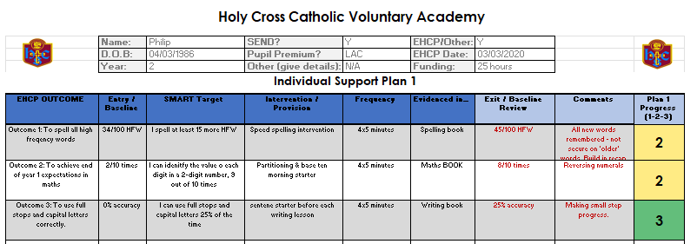
Personal Outcome Plans
Just like the ‘Class Outcome Plans’ but individual to a child with additional funding from the Local Authority (more targets). This plans works in line with a pupils ‘Timetable of Support’…
“In the light of Jesus we Love, Listen and Grow”

Slide 14
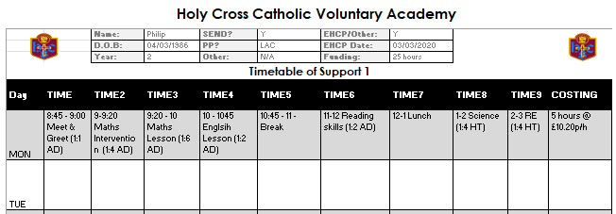
Timetable of Support
The timetable of support reflects the ‘Individual Support Plan’ and how the school uses the additional funding.
“In the light of Jesus we Love, Listen and Grow”

Slide 15
SEND Systems Summary
Stage 0 – Quality teaching for all
Stage 1 – Pupil Passport
Stage 2 – Class Outcome Plans
Stage 3a – Personal Outcome Plan
Stage 3b – Timetable of Support
“In the light of Jesus we Love, Listen and Grow”

Slide 16
Provisions and Interventions
Provision across the school varies from…
One to one support
Small group support
Intervention Group Support
Pre-teaching (intervention before whole class teaching) Proactive.
Overlearning (teaching concepts over and over again)
Post-teaching (intervention after whole class teaching) Reactive.
Immediate teaching/intervention (on the spot).
Precision Teaching (personalised teaching programmes).
ELSA Support (Emotional Literacy Support)
Lego Therapy (Social and communication based Intervention)
Speech and Language Therapy.
“In the light of Jesus we Love, Listen and Grow”

Slide 17
Education, Health and Care Plans
An EHCP is a legal plan which grants the pupil and family additional funding to help support their learning in school. Usually, the funding is given to schools to use and implement in the best way to support the individual.
In order to obtain an EHCP, a school must demonstrate support for a pupil at or around £6,000 (15 hours).
You can find more information about EHCPs from the school SENDCo or the Local Authority website…. www.leics.gov.uk/local_offer
The SENDCo is experienced in identifying pupils who may require an EHCP.
“In the light of Jesus we Love, Listen and Grow”

Slide 18
Emotional Literacy Support
Assistant (ELSA)
At Holy Cross we recognise that there will always be children facing
life challenges that detract from their ability to engage with learning.
As a result, some children will require greater support to increase
their emotional literacy than others. We are pleased to offer the
ELSA Program at Holy Cross, an initiative developed and supported
by Educational Psychologists.
The ELSA at Holy Cross is Mrs N Ward
“In the light of Jesus we Love, Listen and Grow”

Slide 19
SEND & the Curriculum
We recognise that children identified with SEND have strengths in a variety of subjects.
It is our intent to ensure that barriers to learning are removed to ensure our SEND children succeed in the wider curriculum.
Our curriculum is creative, imaginative and meets the needs of all pupils. Giving them transferable knowledge and skills for the next stage in their education.
“In the light of Jesus we Love, Listen and Grow”

Slide 20
Training and Expertise
The SENCo has the National SENCO Award and is a Specialist Leader of Education (SEND)
We aim to keep all school staff up to date with relevant training and developments in relation to the needs of pupils with SEN.
The SENCO attends relevant SEN courses, Family of Schools SEN meetings and signposts relevant SEN focused external training opportunities for all staff.
Staff members responsible for the support of our SEN pupils have experiences and qualifications working within special schools and supporting pupils with MLD, Downs syndromes, Attachment Theory, Palliative care, PMLD, positive handling, dyslexia, numicon, dyspraxia, Lego Therapy, ELSA, ASD, degree in Early childhood studies and foundation degree in early years and young people services.
“In the light of Jesus we Love, Listen and Grow”

Slide 21
Resources and Equipment
Sensory cushions and resources.
Dyslexia friendly reading books.
Coloured Overlays
Pencil grips and specially designed pencils and pens.
Sand timers.
Fine/Gross motor skills activities (Balance see-saw, threading, etc).
Widgets (visuals to support communication)
“In the light of Jesus we Love, Listen and Grow”

Slide 22
Transition
One of the benefits of being a close, family orientated school is that children know the majority of staff. Despite this, we still endeavour to ensure class teachers meet to discuss SEND pupils and that children have an opportunity to be taught by their new class teacher.
Also, it is the little things that help children with SEND settle into a new class. E.g. where there new peg will be and where they will sit can all be agreed before the child steps foot into their new class.
The SENDCo will endeavour to meet with your child’s secondary school SENDCo to ensure they fully understand your child’s needs.
Additional transitioning is arranged as well as normal transition days for Secondary.
If your child is due to transfer to a specialist provision, we will often facilitate transitioning by inviting your chosen secondary school to your child’s October Annual Review (EHCP only).
“In the light of Jesus we Love, Listen and Grow”

Slide 23
Concerns / Complaints
First, speak with your class teacher.
Second, speak to the SENDCo
Thirdly, speak to a member of the SLT (Head of School/Head Teacher)
If this does not resolve your concern, see our complaints policy.
“In the light of Jesus we Love, Listen and Grow”

Slide 24
Governing Body
The SEND Governor is the Governing Body's champion for Learners with SEND and those with inclusion needs. He or she will support and challenge the school to ensure that no Learner is treated less favorably, denied opportunity or left behind because they have additional needs. The SEND governor for Holy Cross is _______________
The SEND governor and SENDCo work closely together and meet approximately once every term.
“In the light of Jesus we Love, Listen and Grow”

Slide 25
Support Services
Specialist Teaching Services Telephone: 0116 305940
Autism Support Service Telephone: 0116 305940
Hearing Support Service Telephone: 0116 305940
Learning Support Service Telephone: 0116 305940
Vision Support Service Telephone: 0116 305940
Psychology Service Telephone: 0116 305510
The Parent Partnership Service Telephone: 0116 305614
SENA - 0116 305660
SEDIASS - 0116 305 5614
Website details of LA local offer: www.leics.gov.uk/local_offer
“In the light of Jesus we Love, Listen and Grow”

Slide 26
Relevant Documentation
You may also be interested in…
School SEND Policy
Safeguarding policy
Behaviour policy
Accessibility Policy
If any of the above are not accessible via our website then please do not hesitate to request a paper copy.
“In the light of Jesus we Love, Listen and Grow”

