Slide 1




PRAYER STATIONS
BOOKLET
For Holy Cross Forest

Slide 2


TABLE OF
Contents
01
Introduction
02
The Rock
03
The Stone Wall
04
The Obstacle
05
The Stream with Water
06
The Stream without Water

Slide 3


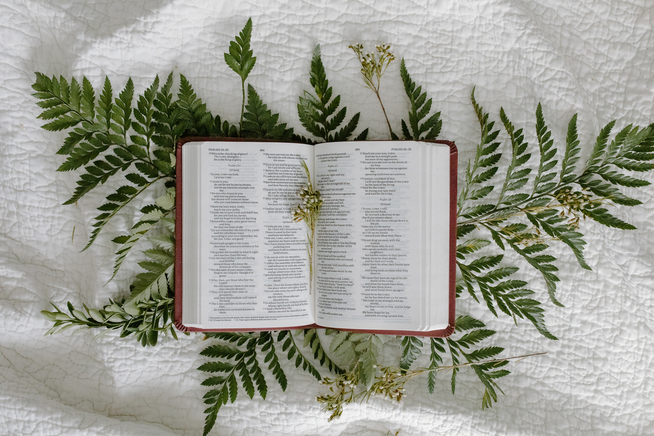
Page 01 of 06
INTRODUCTION
This booklet is designed to be used when completing a prayer walk within Holy Cross Forest School.
Within this booklet, there are pieces of scripture and prayers linked to each station.

Slide 4

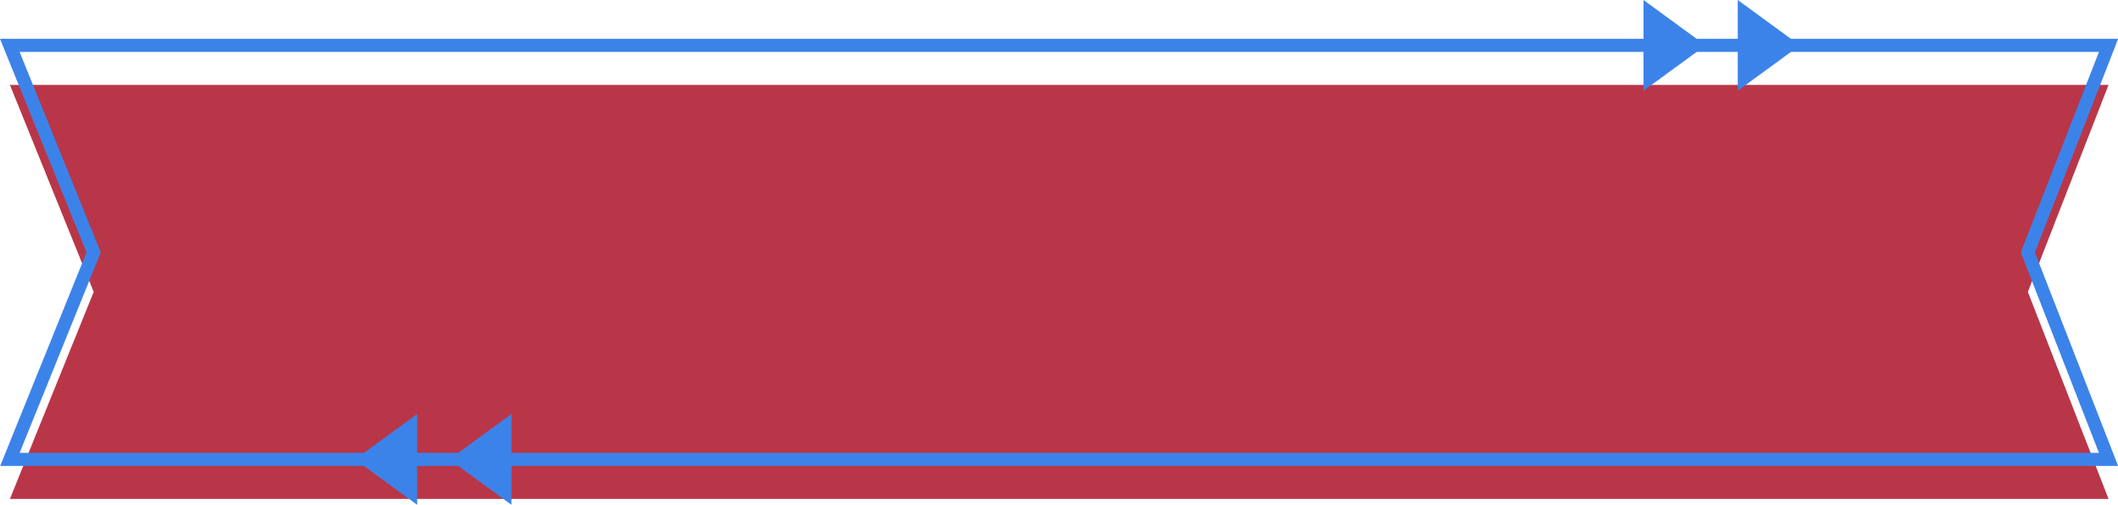
Page 02 of 06
The Rock
A reading from the Holy Gospel according to Matthew
Response: Glory to you O’Lord
Good for you, Simon son of John!” answered Jesus. “For this truth did not come to you from any human being, but it was given to you directly by my Father in heaven. And so I tell you, Peter: you are a rock, and on this rock foundation I will build my church, and not even death will ever be able to overcome it. I will give you the keys of the Kingdom of heaven; what you prohibit on earth will be prohibited in heaven, and what you permit on earth will be permitted in heaven.”
The Gospel of the Lord
Response: Praise to you Lord Jesus Christ
In the name of Father, and of the Son, and of the Holy Spirit, Amen.
Prayer
Our Father
In the name of Father, and of the Son, and of the Holy Spirit, Amen.

Slide 5
Page 03 of 06
The Stone Wall
A reading from the letter of St Paul to the Corinthians
For the body itself is not made up of only one part, but of many parts. If the foot were to say, “Because I am not a hand, I don't belong to the body,” that would not keep it from being a part of the body. And if the ear were to say, “Because I am not an eye, I don't belong to the body,” that would not keep it from being a part of the body. If the whole body were just an eye, how could it hear? And if it were only an ear, how could it smell? As it is, however, God put every different part in the body just as he wanted it to be. There would not be a body if it were all only one part! As it is, there are many parts but one body.
The Word of the Lord
Response: Thanks be to God
In the name of Father, and of the Son, and of the Holy Spirit, Amen.
Prayer
Our Father
In the name of Father, and of the Son, and of the Holy Spirit, Amen.

Slide 6
Page 04 of 06
The Obstacle
A reading from the Holy Gospel according to Luke
Response: Glory to you O’Lord
Very early on Sunday morning the women went to the tomb, carrying the spices they had prepared. They found the stone rolled away from the entrance to the tomb, so they went in; but they did not find the body of the Lord Jesus. They stood there puzzled about this, when suddenly two men in bright shining clothes stood by them. Full of fear, the women bowed down to the ground, as the men said to them, “Why are you looking among the dead for one who is alive? He is not here; he has been raised. Remember what he said to you while he was in Galilee: ‘The Son of Man must be handed over to sinners, be crucified, and three days later rise to life.’”
Then the women remembered his words, returned from the tomb, and told all these things to the eleven disciples and all the rest. The women were Mary Magdalene, Joanna, and Mary the mother of James; they and the other women with them told these things to the apostles. But the apostles thought that what the women said was nonsense, and they did not believe them. But Peter got up and ran to the tomb; he bent down and saw the grave cloths but nothing else. Then he went back home amazed at what had happened.
The Gospel of the Lord
Response: Praise to you Lord Jesus Christ
In the name of Father, and of the Son, and of the Holy Spirit, Amen.
Lord Jesus, You did not let the obstacle of death hold you back.
-------, Amen.
Our Father
In the name of Father, and of the Son, and of the Holy Spirit, Amen.

Slide 7
Page 05 of 06
The Stream with Water
A reading from the Holy Gospel according to Mark
Response: Glory to you O’Lord
On the evening of that same day Jesus said to his disciples, “Let us go across to the other side of the lake.” So they left the crowd; the disciples got into the boat in which Jesus was already sitting, and they took him with them. Other boats were there too. Suddenly a strong wind blew up, and the waves began to spill over into the boat, so that it was about to fill with water. Jesus was in the back of the boat, sleeping with his head on a pillow. The disciples woke him up and said, “Teacher, don't you care that we are about to die?”
Jesus stood up and commanded the wind, “Be quiet!” and he said to the waves, “Be still!” The wind died down, and there was a great calm. Then Jesus said to his disciples, “Why are you frightened? Do you still have no faith?”
But they were terribly afraid and began to say to one another, “Who is this man? Even the wind and the waves obey him!”
The Gospel of the Lord
Response: Praise to you Lord Jesus Christ
In the name of Father, and of the Son, and of the Holy Spirit, Amen.
Prayer
Our Father
In the name of Father, and of the Son, and of the Holy Spirit, Amen.

Slide 8
Page 06 of 06
The Stream without Water
A reading from the book of Psalms:
God is our shelter and strength,
always ready to help in times of trouble.
So we will not be afraid, even if the earth is shaken
and mountains fall into the ocean depths;
even if the seas roar and rage,
and the hills are shaken by the violence.
There is a river that brings joy to the city of God,
to the sacred house of the Most High.
God is in that city, and it will never be destroyed;
at early dawn he will come to its aid.
Nations are terrified, kingdoms are shaken;
God thunders, and the earth dissolves.
⁷ The Lord Almighty is with us;
the God of Jacob is our refuge.
The Word of the Lord
Response: Thanks be to God
In the name of Father, and of the Son, and of the Holy Spirit, Amen.
Prayer
Our Father
In the name of Father, and of the Son, and of the Holy Spirit, Amen.

Slide 9


